Slide 1
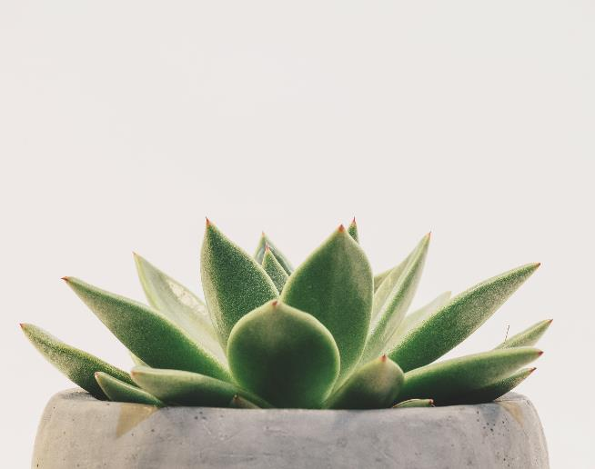
Smart Garden
"An Automated Gardening System for a Greener Tomorrow"
By- Priya Maurya

Slide 2
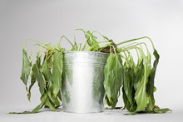
The Challenges of Urban Gardening
Limited space
Water scarcity
Lack of time for maintenance
Pests and diseases

Slide 3
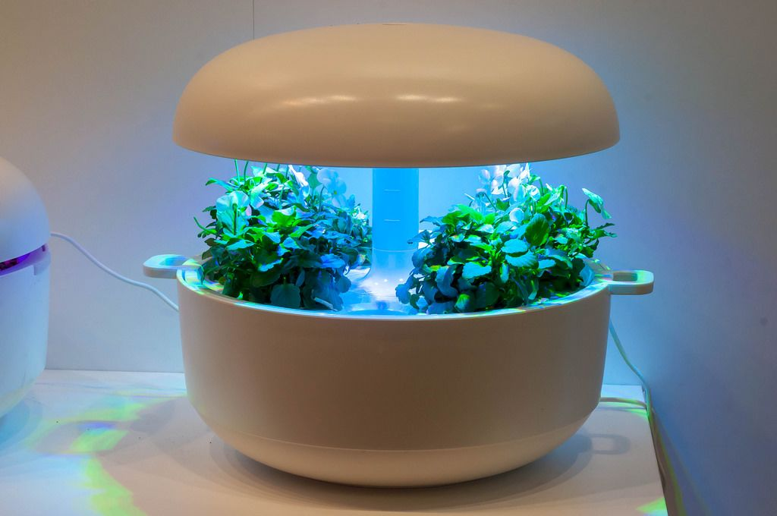
Smart Garden - The Intelligent Gardening Solution"
Automated watering system
Soil moisture sensors
Temperature and humidity control
Pest and disease detection
This Photo by Unknown Author is licensed under CC BY

Slide 4

GARDEN ELEMENTS
Seeds
Plants
Weather

Slide 5

PEAK PLANTING SEASON

Slide 6
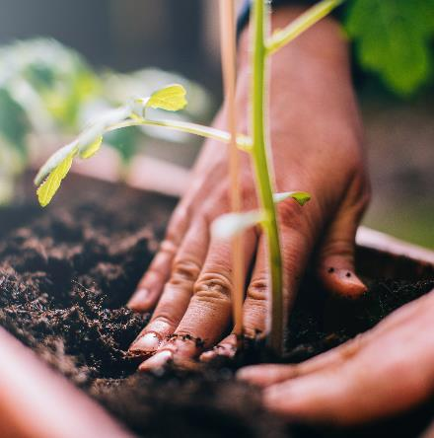
THE PLANTING CYCLE
PLANTING
FEEDING
WATERING
HARVESTING

Slide 7
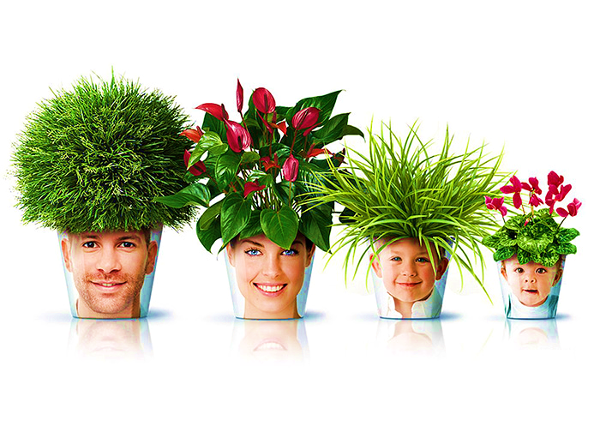
Experience the Power of Smart Garden
Increased crop yield
Water conservation
Reduced maintenance time
Improved plant health
Get Your Smart Garden System

Slide 8

QUIZ

Slide 9
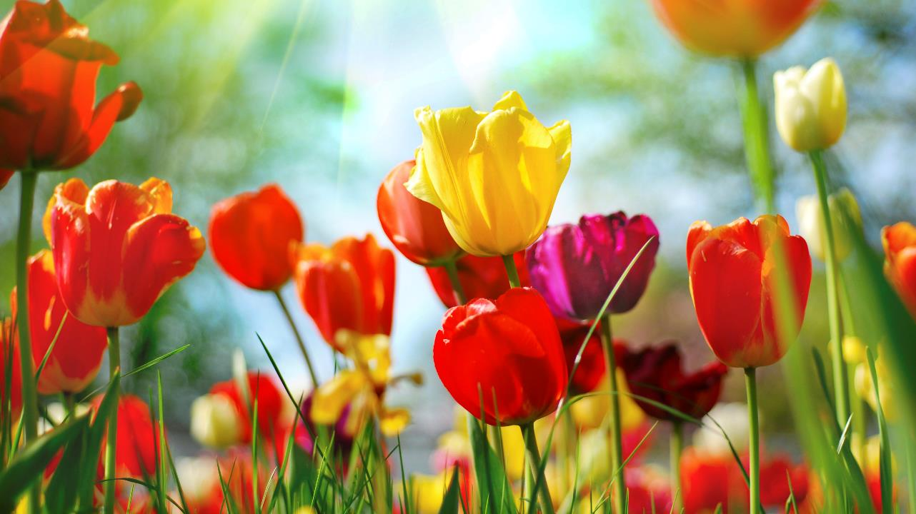
thankyou
mauryapriya8181@gmail.com

